Slide 1
Employee Salary Prediction using Machine Learning
CAPSTONE PROJECT
Presented By:
1. Chandana S – Manipal University Jaipur – Department of Computer science

Slide 2

OUTLINE
Problem Statement (Should not include solution)
System Development Approach (Technology Used)
Algorithm & Deployment (Step by Step Procedure)
Result
Conclusion
Future Scope(Optonal)
References

Slide 3
Problem Statement
In today's fast-paced corporate world, predicting employee salaries accurately is crucial for budgeting, HR planning, and ensuring fair compensation.
Manual estimation often leads to inconsistencies and bias.
There’s a need for a data-driven solution that can use key employee attributes to predict salaries.
This project aims to explore machine learning algorithms to create an accurate salary prediction model.
By automating predictions, organizations can improve decision-making and ensure transparency in compensation.

Slide 4
System Approach
System Requirements:
Laptop Configuration:
Processor: Intel Core i5 / i7 or AMD Ryzen 5 / 7
RAM: Minimum 8 GB (Recommended: 16 GB)
Storage: Minimum 256 GB SSD
OS: Windows 10 / 11 or Ubuntu 20.04+
Software: Anaconda Navigator / Jupyter Notebook
Python Libraries Used:
pandas – Data manipulation
numpy – Numerical computing
matplotlib & seaborn – Data visualization
scikit-learn – Machine learning algorithms
joblib – Model serialization
Dataset:
Source: Local CSV file – salary_prediction_data.csv
Format: Tabular, numeric + categorical fields

Slide 5
Algorithm & Deployment
Step-by-Step Procedure:
Import libraries and load dataset
Exploratory Data Analysis (EDA): histograms, scatter plots, boxplots, heatmaps
Data Preprocessing: handle missing values, encode categorical variables, standardize features
Model Building:
Linear Regression
Decision Tree Regressor
Random Forest Regressor
Model Evaluation: R², MAE, RMSE
Visualization: Regression lines, Decision Tree plot, comparison graphs
Deployment: Save model using joblib for future use
Describe step by step procedure to complete your project

Slide 6
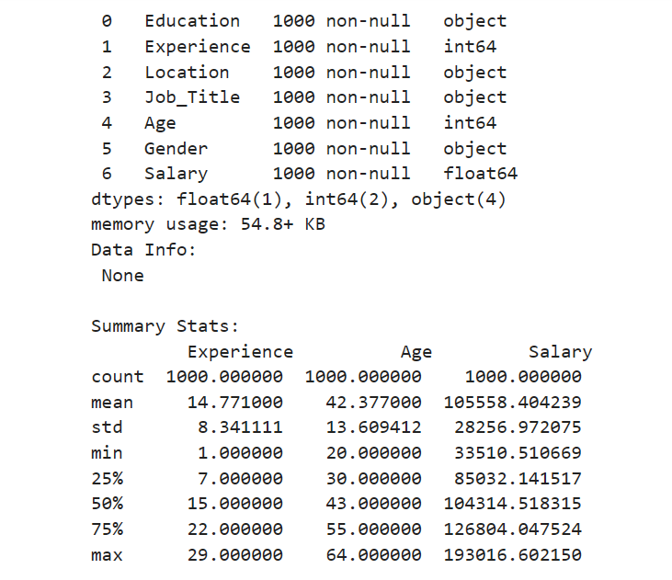
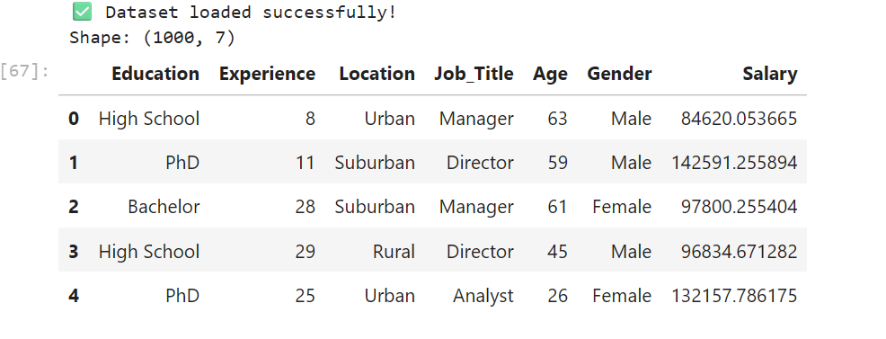
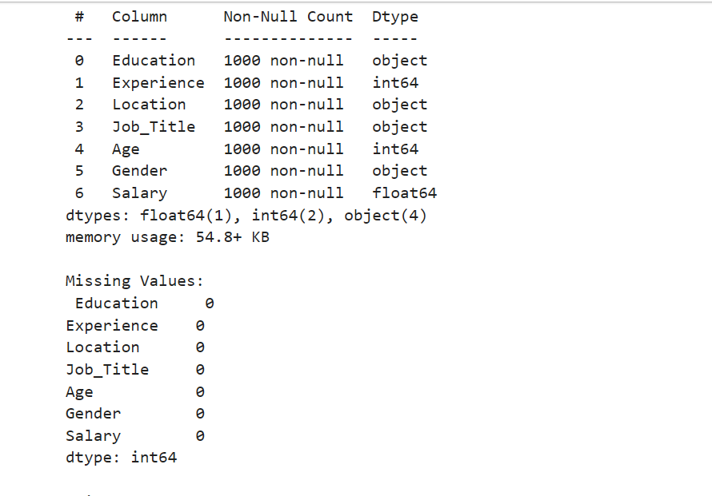
Result

Slide 7
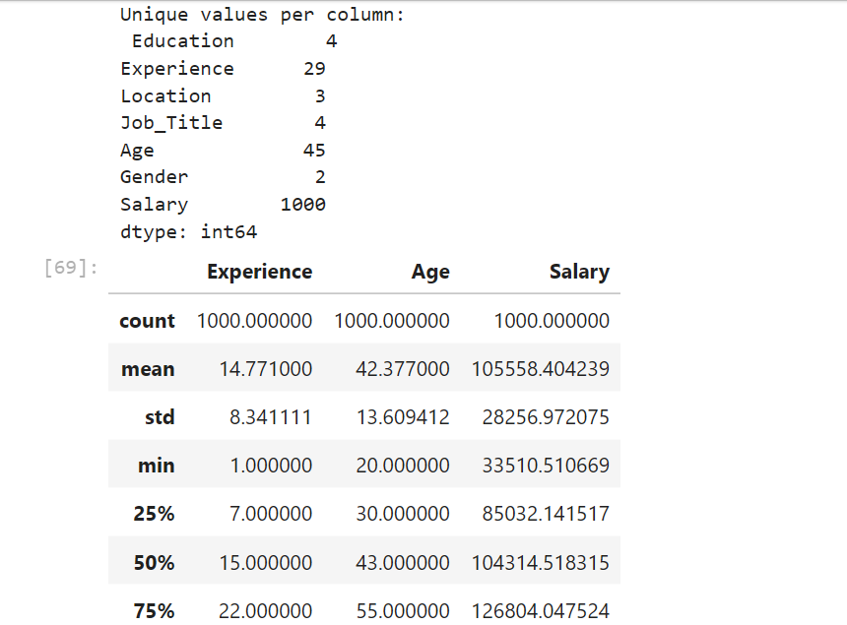
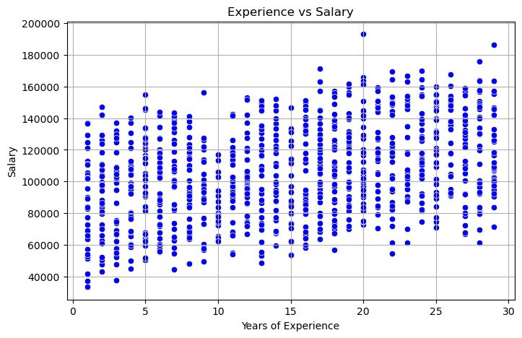
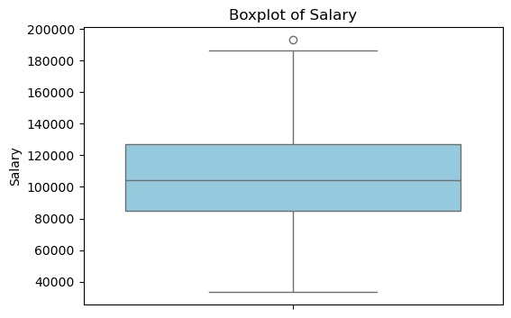
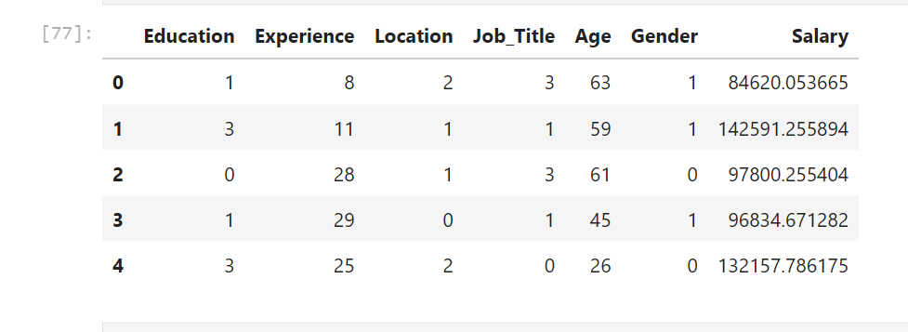

Slide 8
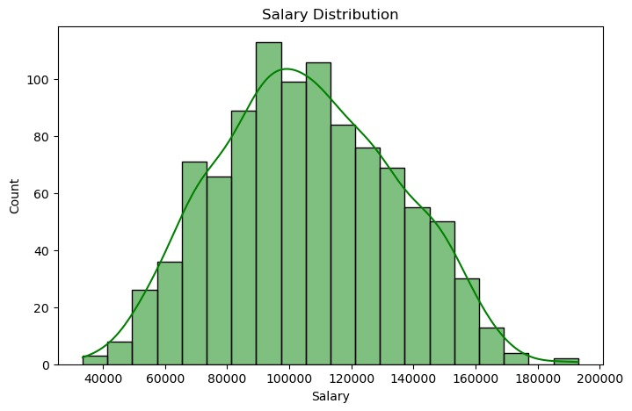
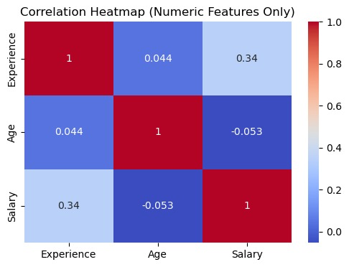

Slide 9
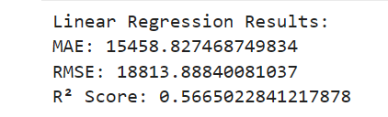
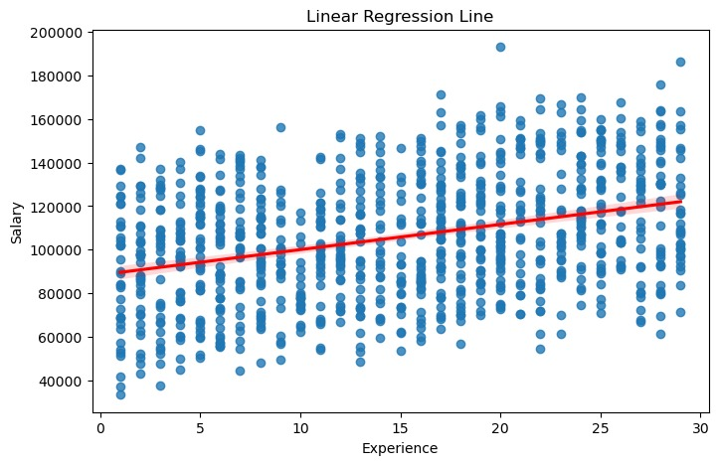
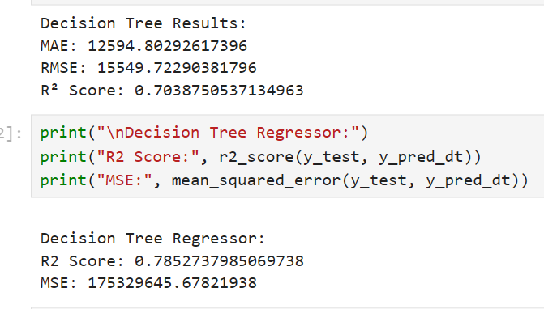

Slide 10
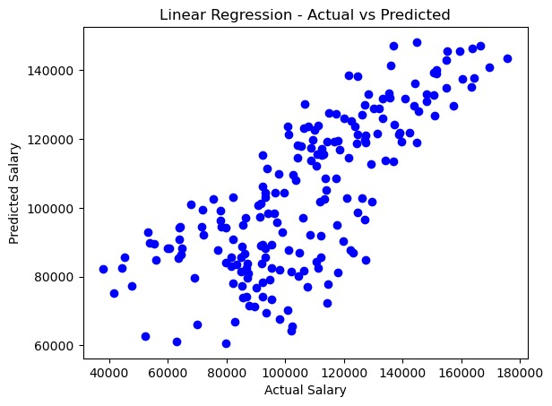
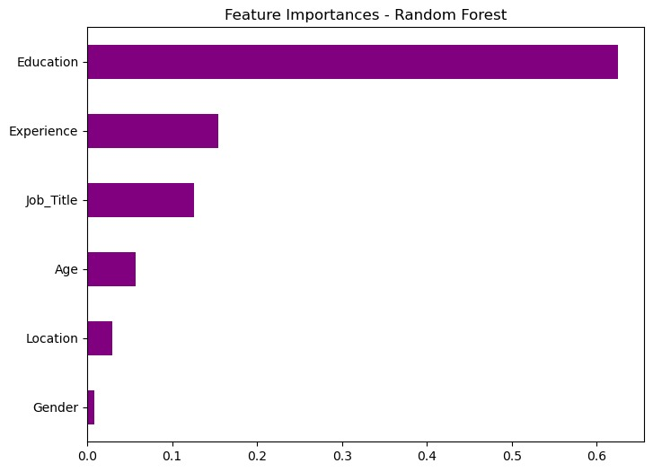
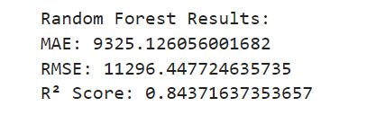

Slide 11
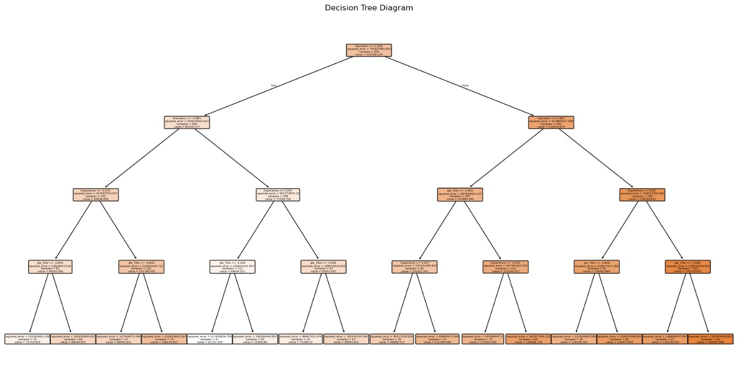

Slide 12
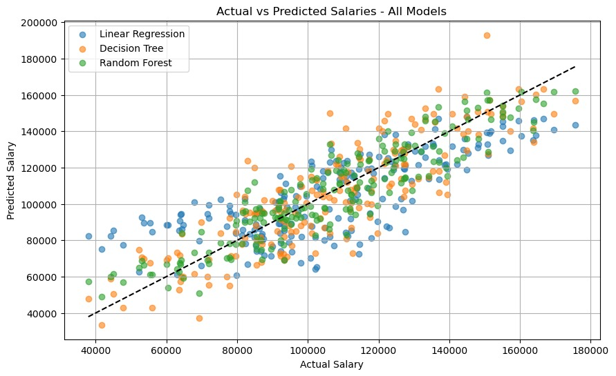

Slide 13
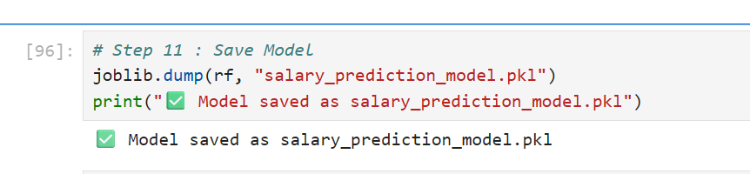
Github link - https://github.com/ChandanaS7/Employee-salary-prediction.git

Slide 14
Conclusion
The machine learning models were effective in predicting employee salaries.
Among the models, Random Forest showed the best performance with the highest R² score and lower error rates.
This project highlights how machine learning can support fair and data-driven decision-making in HR.
Challenges included handling non-numeric data and ensuring models were not overfitting.
Future improvements could involve using more features like role, department, and performance scores.

Slide 15
Future scope(Optional)
Add more features such as education, skills, department, certifications
Deploy the model as a web app using Flask or Streamlit
Use deep learning techniques for higher accuracy
Integrate with company HR databases for real-time predictions

Slide 16
References
https://scikit-learn.org
https://pandas.pydata.org
https://matplotlib.org
Dataset from Kaggle/UCI repository
Stack Overflow and Medium articles on model tuning and salary prediction

Slide 17
THANK YOU

